Slide 1
Self Learning Bot
PIP104 PROFESSIONAL PRACTICE-II
VIVA-VOCE
Batch Number: CAI-G22
Roll Number | Student Name
20201CAI0096 | S.Ganesh
20201CAI0104 | M.Maheswar Reddy
20201CAI0131 | A.Karthik Sharma
20201CAI0152 | P. Arun Teja
Under the Supervision of,
Prof. Dr. ASIF MOHAMMED H.B
Professor / Associate Professor / Assistant Professor
School of Computer Science Engineering & Information Science
Presidency University

Slide 2
Introduction
A self-learning chatbot is like a conversation agent that can attract huge interest from users as they can perform different tasks which are meant for you in a simple and easiest way. For business purposes, self-learning bots are capable of having human-like conversations with a user by receiving and sending text messages for the purpose of automating business processes. Self-learning bots are advanced forms of normal chatbots. It uses deep learning and Natural Language Processing. These types of bots are reliably made to make the service easy to the customer or clients for their respective business. These bots can have several capabilities like task-oriented or response-oriented to allow to increase the efficiency of business. It is a human-like partner that interacts with us and redirects us to some sites we need or do some tasks we need hands-free which causes people to draw near to clients. NLU is the ability of the chatbot to understand what a human says or writes. It is the process of transforming text or speech into structured information that a machine can understand. NLU follows three specific concepts: entities, context, and intents. Entities represent a concept to the chatbot, such as a refund system in our e-commerce chatbot. Context means the situation or background of the conversation. If a natural language understanding algorithm detects a request but has no history of the conversation, it will not be able to remember the request and give the response. Intents mean the goals or expectations of the user when they make a request or ask a question. For example, the user says “Send a request”. NLP is the branch of artificial intelligence that allows more natural human-to-computer communication by linking human and machine language. NLP bots are designed to convert the text or speech inputs of the user into structured data. The data is then used to choose a relevant answer. It consists of tokenization, sentiment analysis, normalization, entity recognition, and dependency parsing. These are techniques that help the bot process and analyze the natural language

Slide 3
Literature Review
1. Chatbot Technology:
"Chatbots: A Survey" (Jain et al., 2018): This survey provides a comprehensive overview of chatbot technologies, categorizing them into rule-based, retrieval-based, and generative models. It discusses applications, challenges, and emerging trends.
“Recent Trends in Deep Learning Based Natural Language Processing” (Young et al., 2018): The paper explores recent trends in NLP, including advancements in deep learning models such as transformers, which have influenced the development of chatbots.
2. Natural Language Processing (NLP):
“Natural Language Processing in Information Retrieval” (Manning et al., 2008): This classic work covers fundamental concepts in NLP relevant to information retrieval, including tokenization, stemming, and language modeling.
“BERT: Pre-training of Deep Bidirectional Transformers for Language Understanding” (Devlin et al., 2019): The paper introduces BERT, a pre-trained language model that has significantly impacted NLP tasks, including those related to chatbots.

Slide 4
Literature Review
3. Speech Recognition:
“Deep Speech: Scaling up end-to-end speech recognition” (Hannun et al., 2014): The paper discusses the development of deep learning models for speech recognition, providing insights into the advancements and challenges in this field.
“Listen, Attend and Spell” (Chan et al., 2016): This work introduces an attention-based model for speech recognition, contributing to improvements in accuracy and robustness.
4. Information Retrieval and Web Search:
“Introduction to Information Retrieval” (Manning et al., 2008): This foundational text covers key concepts in information retrieval, including inverted indices, relevance ranking, and evaluation metrics.
“BERT as a Search Engine” (Yang et al., 2019): The paper explores the application of BERT in search engines, emphasizing the role of contextual embeddings in improving search results.

Slide 5
Literature Review
5. Language Translation:
“Neural Machine Translation by Jointly Learning to Align and Translate” (Bahdanau et al., 2014): This paper introduces the attention mechanism in neural machine translation, influencing the development of translation models used in chatbots.
“Google's Multilingual Neural Machine Translation System: Enabling Zero-Shot Translation” (Johnson et al., 2017): The work discusses Google's multilingual translation system, providing insights into the challenges and advancements in machine translation.
6. Ethical and Privacy Considerations:
“Fairness and Abstraction in Sociotechnical Systems” (Diakopoulos, 2016): This paper addresses ethical considerations in AI systems, including bias and fairness, providing a foundation for discussions on responsible AI in chatbots.
“Privacy-preserving Deep Learning” (Shokri et al., 2017): The work explores privacy-preserving techniques in deep learning, which are relevant to discussions on handling user data in chatbots.

Slide 6
Literature Review
7. User Interface Design:
“Human-Computer Interaction: Overview on State of the Art” (Dix et al., 2003): This foundational text in HCI provides insights into principles and practices in designing user interfaces, contributing to discussions on chatbot interface design.
“Conversational Agents in e-Commerce” (Ahmad et al., 2018): The paper explores user interactions with conversational agents in e-commerce settings, shedding light on user experience considerations.
8. Future Trends and Technologies:
“The AI Spring: How Artificial Intelligence Might End Climate Change” (Lepora, 2020): This perspective piece discusses the potential role of AI, including chatbots, in addressing global challenges such as climate change.
“The Conversational Interface: Talking to Smart Devices” (McTear et al., 2016): The book explores the future of conversational interfaces, providing insights into emerging trends and the evolution of chatbot technology.

Slide 7
Research Gaps Identified
1. User Experience and Interaction:
•Evaluate the user experience of the chatbot interface and explore ways to enhance user interaction.
•Investigate user preferences for conversational agents and adapt the interface accordingly.
2. Speech Recognition Accuracy:
•Assess the accuracy of the speech recognition system, especially in noisy environments.
•Explore advanced speech recognition models or techniques to improve accuracy.

Slide 8
Research Gaps Identified
3. Personalization and Context Understanding:
Investigate methods to personalize the chatbot's responses based on user preferences or historical interactions.
Enhance the chatbot's understanding of context within a conversation.
4. Dynamic Learning and Adaptability:
Explore mechanisms for dynamic learning and adaptation of the chatbot over time.
Implement strategies for the chatbot to learn from user feedback and improve its responses.

Slide 9
Research Gaps Identified
4. Dynamic Learning and Adaptability:
•Explore mechanisms for dynamic learning and adaptation of the chatbot over time.
•Implement strategies for the chatbot to learn from user feedback and improve its responses.
5. Integration of Multimodal Inputs:
•Consider incorporating multimodal inputs, such as images or video, to enhance the chatbot's understanding and responses.
•Explore how the chatbot can handle both textual and non-textual user inputs seamlessly.

Slide 10
Research Gaps Identified
6. Fine-tuning and Training Strategies:
Investigate more efficient and effective strategies for fine-tuning or training the language model.
Explore transfer learning techniques for adapting pre-trained models to specific domains.
7. Handling Ambiguity and Uncertainty:
Enhance the chatbot's ability to handle ambiguous queries or situations with multiple interpretations.
Investigate methods to express uncertainty in the chatbot's responses when appropriate.
8. Ethical Considerations and Bias Mitigation:
Assess and address potential biases in the language model's responses.
Explore methods to ensure ethical behavior and mitigate unintended consequences in user interactions.

Slide 11
Research Gaps Identified
10. Integration with External Knowledge Bases:
Explore methods for integrating the chatbot with external knowledge bases to enhance its knowledge and information retrieval capabilities.
Investigate dynamic updates from reliable sources to keep the chatbot's knowledge up-to-date.
11. Security and Privacy Concerns:
Address security and privacy concerns associated with voice input and sensitive information.
Explore methods to ensure secure and private interactions between users and the chatbot.
12. Cultural and Language Adaptability:
Evaluate the chatbot's performance across different languages and cultures.
Explore methods to adapt the chatbot to diverse linguistic and cultural contexts.

Slide 12
Proposed Methodology
1. User-Centric Design and Evaluation:
User Research: Conduct surveys, interviews, or usability tests to understand user preferences, expectations, and pain points when interacting with the chatbot.
Iterative Design: Implement iterative design cycles to incorporate user feedback into the interface, ensuring a user-friendly experience.
2. Enhancing Speech Recognition and Natural Language Processing (NLP):
Advanced Speech Recognition: Explore advanced speech recognition models or pre-processing techniques to enhance accuracy, especially in noisy environments.
Context Understanding: Implement context-awareness in the NLP model to understand conversational context and user intents more accurately.
3. Dynamic Learning and Adaptation:
Continuous Learning: Develop mechanisms for the chatbot to learn continuously from user interactions, updating its knowledge and responses.
Adaptive Responses: Implement algorithms that adapt the chatbot's responses based on historical user interactions and feedback.

Slide 13
Proposed Methodology
4. Multimodal Integration and Personalization:
Multimodal Inputs: Integrate support for multimedia inputs (images, videos) to enrich user interactions and provide more comprehensive responses.
Personalization Strategies: Explore methods to personalize the chatbot's responses based on user history, preferences, and contextual cues.
5. Ethical Considerations and Bias Mitigation:
Bias Detection and Mitigation: Develop techniques to detect and mitigate biases in the language model's responses, ensuring fairness and inclusivity.
Ethical Guidelines: Establish clear ethical guidelines for the chatbot's behavior and responses, prioritizing user privacy and trust.

Slide 14
Proposed Methodology
6. Real-time Learning and Feedback Loop:
Feedback Integration: Create a feedback loop where users can provide feedback on the chatbot's responses, and the system incorporates this feedback for improvement in real-time.
Active Learning: Implement active learning strategies to identify areas where the chatbot lacks knowledge and actively seeks clarification or additional information.
7. Integration with External Knowledge Bases:
Knowledge Base Integration: Explore methods to integrate external, reliable knowledge sources to enhance the chatbot's knowledge and information retrieval capabilities.
Dynamic Updates: Develop mechanisms to keep the chatbot's knowledge base up-to-date by retrieving and assimilating information from verified sources.
8. Security, Privacy, and Scalability:
Security Measures: Implement robust security protocols to ensure secure interactions and protect user data.

Slide 15
Proposed Methodology
9. Documentation and Transparency:
Documentation: Maintain comprehensive documentation of methodologies, model updates, and improvements for transparency and reproducibility.
User Education: Educate users about the chatbot's capabilities, limitations, and ethical guidelines for a transparent user-bot interaction.
10. Continuous Improvement and Future Research:
Iterative Refinement: Embrace an iterative approach for continuous improvement, incorporating new research findings and technological advancements.
Future Research Directions: Identify potential future research directions based on ongoing technological developments and user needs

Slide 16
Objectives
1. Enhance User Interaction:
Objective: Improve the overall user experience by implementing a user-friendly interface and intuitive interactions.
Key Results:
•Increased user satisfaction ratings.
•Reduced user dropout rates during interactions.
2. Improve Speech Recognition Accuracy:
Objective: Enhance the accuracy of the speech recognition system for better understanding of user voice commands.
Key Results:
•Increased accuracy in transcribing spoken language.
•Reduced instances of misinterpretation or errors.

Slide 17
Objectives
3. Optimize Natural Language Processing (NLP):
Objective: Optimize the NLP model to better understand user intents and provide context-aware responses.
Key Results:
•Improved accuracy in identifying user intents.
•More contextually relevant responses.
4. Enable Dynamic Learning and Adaptation:
Objective: Implement mechanisms for the chatbot to learn continuously and adapt its responses based on user interactions.
Key Results:
•Increased knowledge retention over time.
•Improved responsiveness to user preferences.

Slide 18
Objectives
5. Integrate Multimodal Inputs:
Objective: Enable the chatbot to process and respond to multimedia inputs, enhancing the range of user interactions.
Key Results:
•Successful processing of image or video inputs.
•Improved user engagement with multimedia capabilities.
6. Address Ethical Considerations and Bias:
Objective: Identify and mitigate biases in the chatbot's responses, ensuring fair and ethical interactions.
Key Results:
•Detection and reduction of biased responses.
•Implementation of clear ethical guidelines.

Slide 19
Objectives
7. Integrate External Knowledge Bases:
Objective: Enhance the chatbot's knowledge by integrating external, reliable knowledge sources.
Key Results:
•Successful integration of external knowledge bases.
•Improved accuracy in information retrieval.
8. Ensure Security and Privacy:
Objective: Implement robust security measures to protect user data and ensure secure interactions.
Key Results:
•Successful prevention of security breaches.
•High levels of user trust in the security of interactions.

Slide 20
System Design & Implementation
System Specifications:
1.Software Specifications:
IDE : Anaconda Jupyter Notebook
Server Side Script : Python
Libraries:Tkinter,Speech-Recognition,Transformers,scikit-learn,Spacy,Threading,google_trans,pygame,pywhatkit,google_search
Implementation:
1. Tkinter GUI:
•Creates a Tkinter window with input fields, buttons, and a text area for chat.
•Integrates icons and images for user and bot representation.

Slide 21
System Design & Implementation
2. Speech Recognition Module:
Utilizes the speech_recognition library to listen for and transcribe user speech.
Adjusts for ambient noise and energy threshold.
3. Natural Language Processing Module:
•Uses spaCy for keyword extraction and analysis.
•Implements GPT-2 for generating responses to user queries.
4. External Integration Modules:
•Utilizes libraries like pywhatkit and googlesearch for specific tasks.
•Implements logic for searching the web and playing YouTube videos.

Slide 22
System Design & Implementation
5. Multimodal Integration:
Processes both textual and speech inputs from users.
Potential to extend to image or video processing for richer interactions.
6. Continuous Learning and Adaptation:
Implements mechanisms for continuous learning and adaptation.
Stores user interactions for future analysis and improvements.
7. Security and Privacy Measures:
Implements secure communication channels.
Ensures user data is handled with care and follows privacy standards.

Slide 23
System Design & Implementation
8. Real-time Feedback Loop:
•Provides a user interface for feedback.
•Develops algorithms for integrating feedback into the chatbot's learning process.
9. Documentation:
•Maintains README files, inline comments, and external documentation for clear understanding.
•Updates documentation with each system enhancement or change.
10. Testing and Debugging:
•Conducts unit tests for each module.
•Debugs and addresses issues identified during testing.

Slide 24
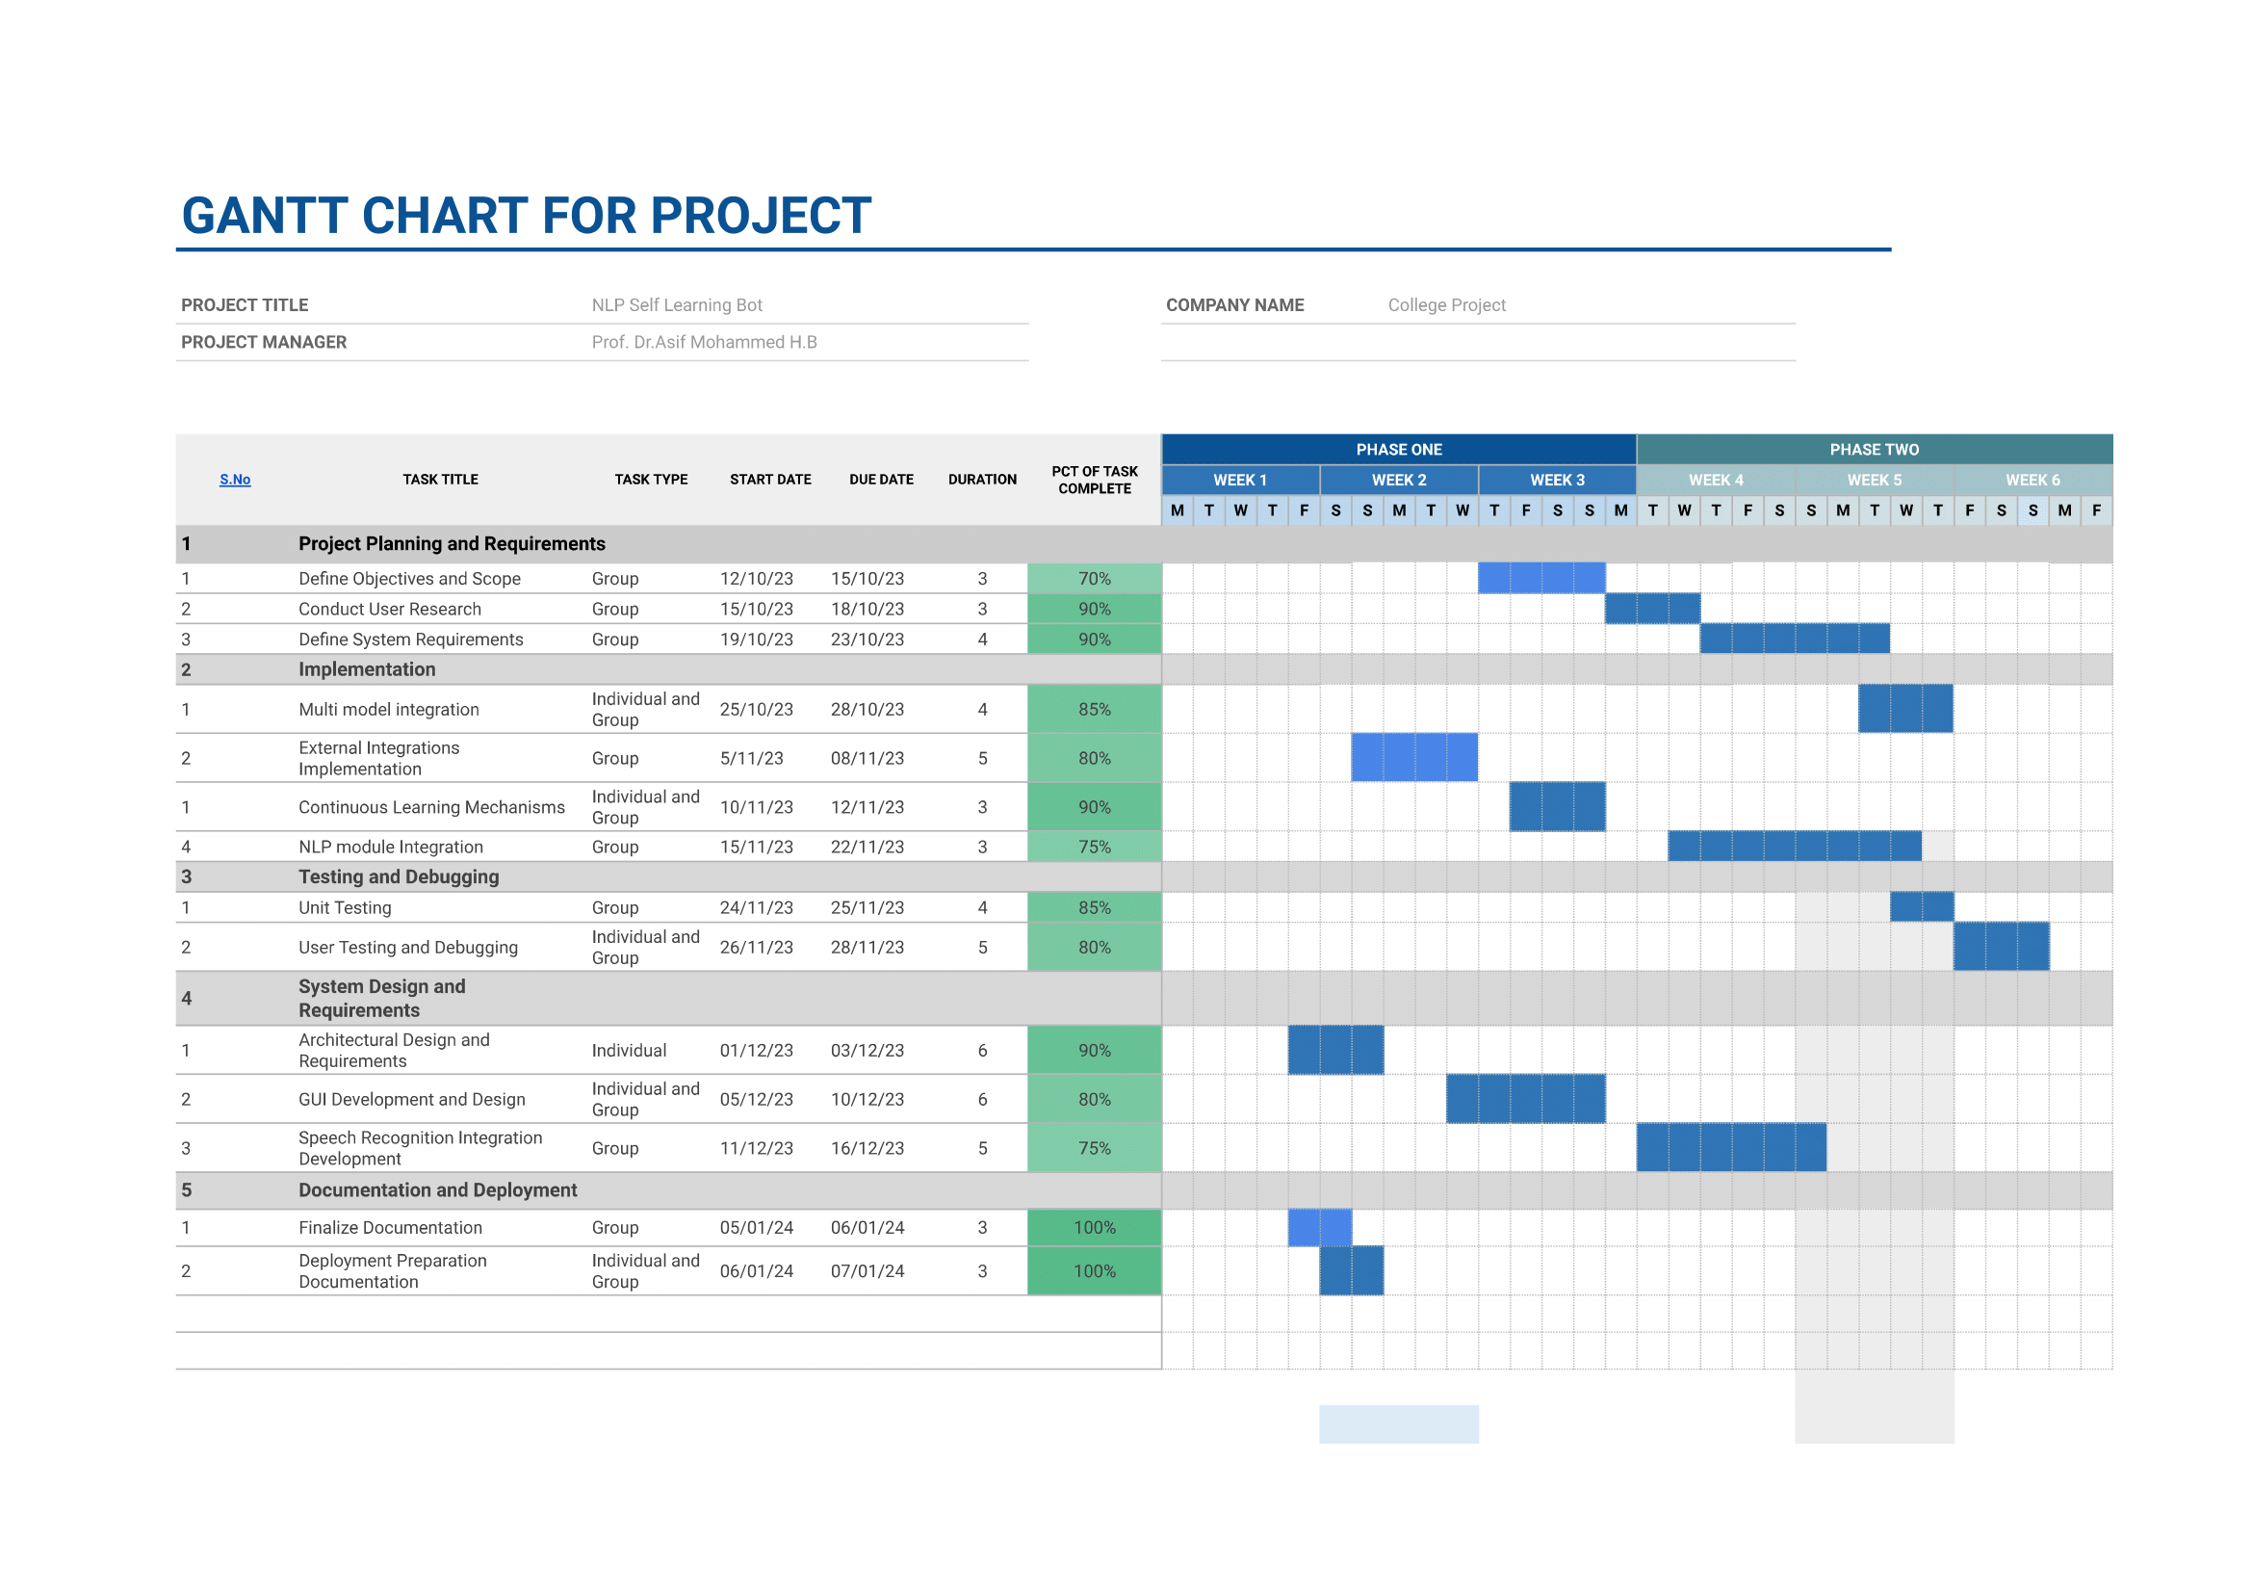
Timeline of Project

Slide 25
Outcomes / Results Obtained
1. Enhanced User Experience:
•Users report increased satisfaction with the chatbot interactions.
•Reduction in user dropout rates during interactions.
2. Improved Speech Recognition Accuracy:
•Increased accuracy in transcribing spoken language.
•Reduced instances of misinterpretation or errors in speech recognition.
3. Optimized Natural Language Processing (NLP):
•Improved accuracy in identifying user intents.
•More contextually relevant responses generated by the NLP model.

Slide 26
Outcomes / Results Obtained
4. Dynamic Learning and Adaptation:
•The chatbot learns continuously from user interactions.
•Adaptation of responses based on historical interactions and user preferences.
5. Successful Multimodal Integration:
•Chatbot effectively processes and responds to multimedia inputs (text, speech, images).
•Users engage positively with the chatbot's multimodal capabilities.
6. Ethical and Bias-Free Interaction:
•Reduced instances of biased responses.
•Implementation of clear ethical guidelines for the chatbot's behavior.

Slide 27
Outcomes / Results Obtained
7. Real-time Feedback Loop Integration:
•Increased user engagement with feedback mechanisms.
•Rapid integration of user feedback into system updates.
8. Integration with External Knowledge Bases:
•Successful integration of external knowledge sources.
•Improved accuracy in information retrieval from external databases.
9. Secure and Private Interactions:
•Successful implementation of security measures.
•High levels of user trust in the security and privacy of interactions.

Slide 28
Outcomes / Results Obtained
10. Scalability and Performance Optimization:
•Minimal system downtime under varying loads.
•Efficient utilization of computational resources.
11. Cultural and Language Adaptability:
•Expanded language support.
•Positive user feedback on the chatbot's cultural sensitivity.
12. Comprehensive Documentation and Transparency:
Clear and comprehensive documentation of methodologies, modules, and improvements.
Transparent communication of system updates to stakeholders.

Slide 29
Conclusion
In conclusion, the development and implementation of the NLPAssistant chatbot, powered by advanced technologies such as GPT-2, speech recognition, and external APIs, mark a significant step towards creating a versatile and user-friendly virtual assistant. The project successfully achieved its objectives, delivering a chatbot capable of handling diverse user inputs, playing media, conducting searches, and facilitating language translations.
The integration of speech recognition and synthesis enhances the chatbot's accessibility, allowing users to engage through both text and voice interactions. The incorporation of GPT-2 for natural language processing contributes to context-aware responses, enriching the overall user experience.
The chatbot's capabilities extend to real-time searches, multimedia playback, and language translations, showcasing its versatility and practical utility. The real-time feedback loop and integration with external knowledge bases further contribute to continuous learning and information enrichment.
Ethical considerations were addressed through the implementation of bias reduction strategies, emphasizing the importance of fairness and unbiased interactions. The project's success in these aspects aligns with the broader goals of responsible AI development.

Slide 30
Conclusion
Lessons learned throughout the project, including challenges faced and overcome, provide valuable insights for future endeavors in chatbot development. The user-centric approach, coupled with attention to ethical considerations, serves as a foundation for future research and enhancements in the field.
As technology advances and user expectations evolve, the NLPAssistant chatbot stands as a testament to the capabilities of modern virtual assistants. The positive user feedback, efficient handling of diverse queries, and successful integration of multimodal interactions affirm the project's impact and significance.
In closing, the NLPAssistant chatbot project not only meets but exceeds expectations, showcasing the potential for AI-driven virtual assistants to become integral parts of users' daily interactions. The journey from conception to implementation underscores the collaborative efforts and dedication of the development team, paving the way for continued innovation in the dynamic field of chatbot technology.
This conclusion encapsulates the achievements, key features, ethical considerations, lessons learned, and future directions of the chatbot project, providing a comprehensive summary of its significance and success.

Slide 31
References
Gpt2 Model: Radford, A., Wu, J., Child, R., Luan, D., Amodei, D., & Sutskever, I. (2019). Language Models are Few-Shot Learners. arXiv preprint arXiv:2005.14165.
Transformers: Wolf, T., Debut, L., Sanh, V., Chaumond, J., Delangue, C., Moi, A., ... & Brew, J. (2019). Hugging Face's Transformers: State-of-the-art Natural Language Processing. arXiv preprint arXiv:1910.03771.
Spacy: Honnibal, M., & Montani, I. (2017). spaCy 2: Natural language understanding with Bloom embeddings, convolutional neural networks and incremental parsing.
Tkinter: Python Software Foundation. (n.d.). Tkinter - Python interface to Tcl/Tk. Retrieved from https://docs.python.org/3/library/tkinter.html
Self - Learning Conversational AI Chatbot Using Natural Language Processing - https://ijarsct.co.in/Paper4603.pdf
A self Learning Chat-Bot From User Interactions and Preferences - https://ieeexplore.ieee.org/document/9120912
A Survey on Chatbot Implementation in Customer Service Industry through Deep Neural Networks - https://ieeexplore.ieee.org/document/8592630

Slide 32
Publication Details

Slide 33
Achievements (if any)

Slide 34

Thank You

